Slide 1
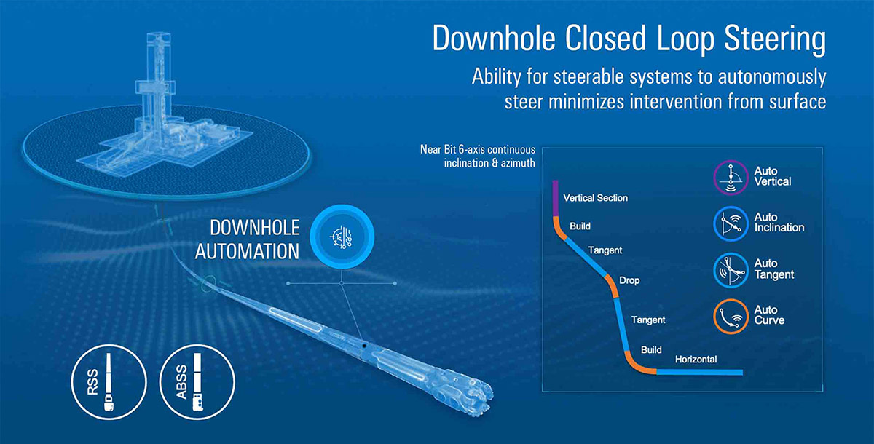
Twin Digital Autonomous System For Directional Drilling
UMaT Drillbotics

Slide 2
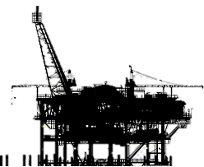
Unveiling the Earth's Secrets
Drilling is a crucial process used to penetrate the Earth's surface, revealing valuable information about its composition, resources, and geological history.
Drilling is the primary method used to extract hydrocarbons from the Earth's subsurface.
It involves creating deep holes or wells in the Earth's crust, allowing access to subsurface materials that are otherwise hidden from direct observation.

Slide 3
Types of drilling
In the oil and gas industry;
vertical and
directional
drilling methods have been employed to intersect reservoirs and extract hydrocarbons.
Each method comes with its own set of advantages and disadvantages.

Slide 4
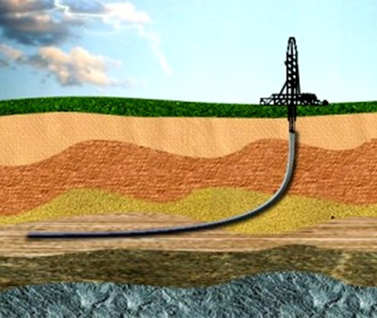
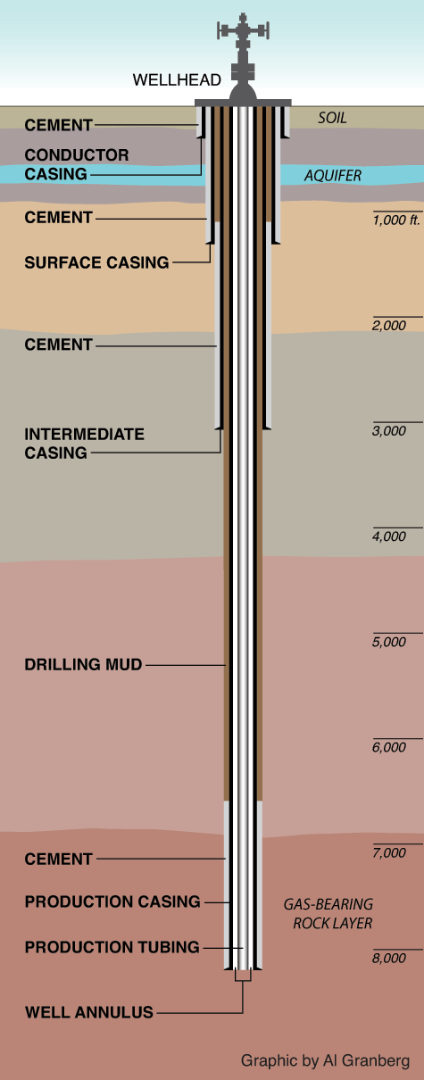
Vertical VS Directional Drilling
Directional drilling
Vertical drilling

Slide 5
Vertical VS Directional Drilling Continued
Table 1: Comparison of Vertical and Directional Drilling
Aspect | Vertical Drilling | Directional Drilling
Access to remote reserves | Limited | Enhanced
Reservoir contact | Limited | Maximized
Geologic flexibility | Limited | Increased
Operational efficiency | Good | Improved
Environmental impact | Potential disturbance | Reduced footprint
Wellbore stability | High | Enhanced
Cost effectiveness | Applicable for simple projects | Potential cost savings
Safety hazards | Standard | Reduced Risk

Slide 6
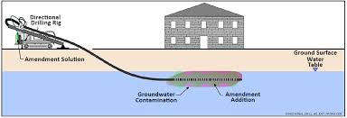
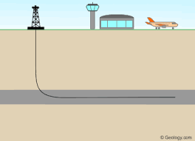
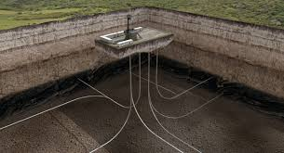
Benefits of Directional Drilling
The oil and gas industry increasingly utilizes directional drilling for its projects due to significant benefits including;
Access to remote reserves
Increased reservoir contact
Improved productivity.
Flexibility in navigating challenging geologic formations and reduces environmental impact.

Slide 7
Computer-Aided Drilling: Enhancing Efficiency and Reducing Costs
Traditional Drilling Challenges:
Lacks efficient analysis of tools and equipment.
Extra costs
Introduction to Computer-Aided Drilling:
Optimize tool and equipment selection.
It ensures faster, safer, and more accurate analysis
Benefits of Computer-Aided Drilling:
Efficiency
Cost Reduction
Well cost
Well plan efforts
Notes:
Relying solely on survey data, traditional drilling lacks efficient analysis of tools and equipment.
Extra costs arise from bringing up downhole equipment for component changes due to encountered problems.
Computer-Aided Drilling utilizes data analysis and predictions to optimize tool and equipment selection.
It ensures faster, safer, and more accurate analysis based on available data and well survey predictions.
Efficiency: Enables efficient analysis of tools and equipment for enhanced drilling performance.
Cost Reduction: Reduces expenses by eliminating unnecessary trips to the surface for component changes.

Slide 8
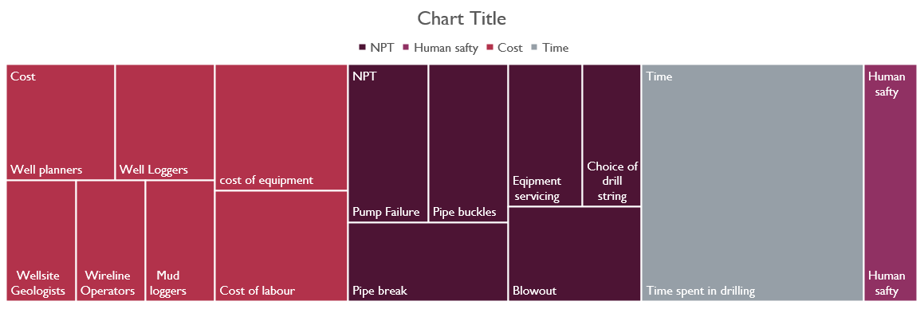
Traditional and drilling procedure cost involved

Slide 9
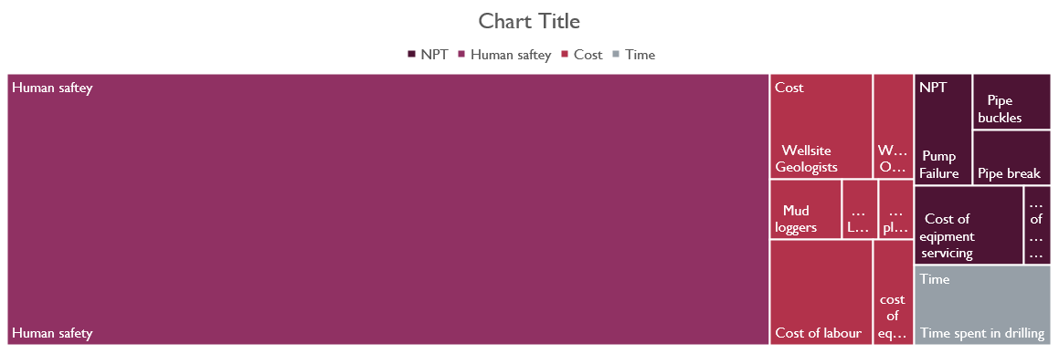
Computer aided drilling and costs involved

Slide 10
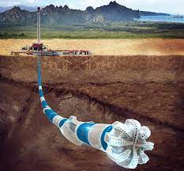
Computer-Aided Drilling: Unlocking Efficiency & Safety
Real-time data analysis and predictive models optimize drilling.
Minimizes errors, enhances safety, and prevents downtime.
Revolutionizes tool analysis, reducing costs & improving outcomes.
Smarter decisions based on data and predictions.
Automation boosts efficiency, ensures outstanding results.

Slide 11
Proactive Planning and Automation
Proactive planning and automation are crucial for minimizing costs in directional drilling. Our project involves;
Creating a digital twin of the drilling process
Automating it while considering human input.
This approach surpasses conventional software solutions by integrating;
Well planning
Automatic and efficient selection of drilling equipment(Drill string).
Precise well steering.

Slide 12
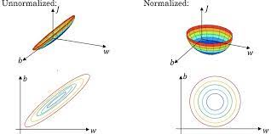
Leveraging Advanced Technologies and AI
By leveraging digital twins, real-time data analysis, and artificial intelligence (AI), our system simulates and optimizes the directional drilling process before operations begin. This comprehensive approach, combined with our own derived efficient equipment selection algorithms, reduces costs, improves efficiency, and enhances safety by minimizing errors and intervention.
Normalization of data for drill string selection

Slide 13
Unlocking the Future of Drilling
Our virtual drilling system revolutionizes the oil and gas industry by leveraging advanced technologies, including digital twins, real-time data analysis, and artificial intelligence. With enhanced productivity, improved safety, and reduced costs, we are shaping a more efficient and sustainable future in drilling.
Join us on this transformative journey as we lead the way towards optimized operations and increased environmental responsibility.
Thank you

